Slide 1

Spring Boot-y-ful Cloud Microservices
Aniruddha Jadhao

Slide 2
Evolution of Microservices
First posted as DevOps revolution architecture.
Automating manuals tasks of m/c provisioning , deployments - reason being services offered in marked at cheap rates.
Release service to customer need
Pack and release the only services customer demand.
Race of First to innovate , Quick to release
Independent functionality that suffices market coming need, can be released independently than all in(with big single app) one package
Race of First to innovate , Quick to release
Independent functionality that suffices market coming need, can be released independently than all in(with big single app) one package
Faster time to reach market

Slide 3
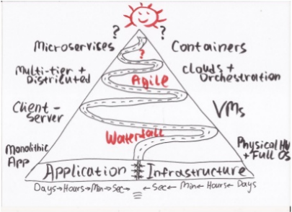

Evolution of Microservices

Slide 4
Difficulties with Monolithics
Large monolithic code base makes complicated to understand
Scaling become challenging
Continuously integration / deployment become complex and time consuming. You may require dedicated team for build and deploy
Overloaded IDE, Large code base makes IDE slow, build time increase.
Extremely difficult to change technology or language or framework because everything is tightly coupled and depend up on each other.

Slide 5
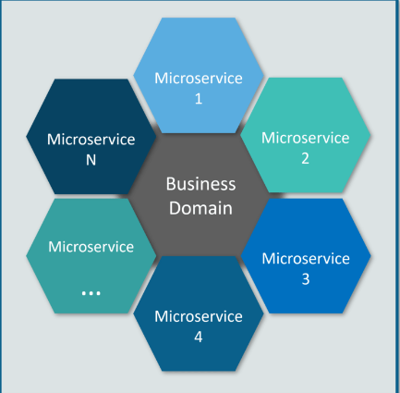
Privilege with Microservice architecture, when it grow
Each microservice is small and focused on a specific feature / business requirement.
Microservice can be developed independently by small team of developers (normally 2 to 5 developers).
Microservice is loosely coupled, means services are independent, in terms of development and deployment both.
Microservice can be developed using different programming language .
Microservice allows easy and flexible way to integrate automatic deployment with Continuous Integration tools (for e.g: Jenkins, Hudson, bamboo etc..). The productivity of a new team member will be quick enough.
Microservice allows you to take advantage of emerging and latest technologies (framework, programming language, programming practice, etc.).
Microservice is easy to scale based on demand. In a nutshell, monolithic vs microservice architecture is like elephant vs ant approach. What you wants to build a giant system like elephant or army of ant, small, fast and effective.

Slide 6
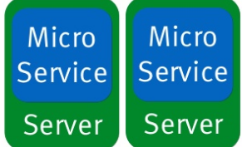
Microservices : Definition
Small Autonomous Services that work with each other together
Architectural Style , single suit of small services built around business capabilities, running its own process , communicating light weight mechanisms like over http
Independent deployable units by automated deployments
Any technology/infrastructure

Slide 7

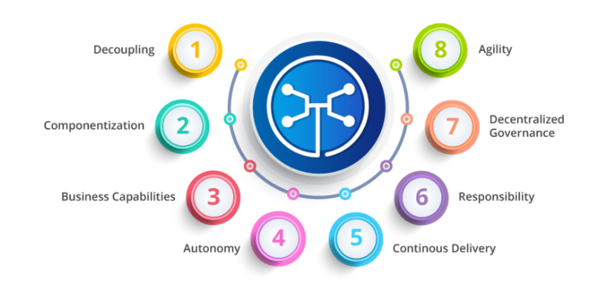
Challenges Building Microservices
Bounded context
Evolutionary process
Follow DDD
Best of knowledge at that point of time
Configuration Management
Load of microservices configuration
How do we simplify?
Load balancing / dynamically bring up and down
How to achieve HA/scaling easily and simply?
Visibility
Identify bug in between many microservices flow
Need distributed tracing to monitor/logs etc
If not designed properly it can be pack of cards, entire app can collapse
Needs Fault tolerance

Slide 8
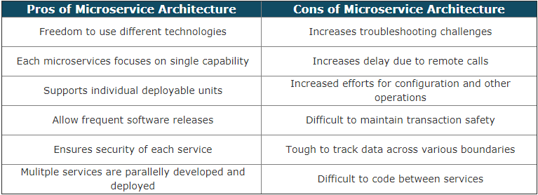
Pros & Cons

Slide 9

What’s in it for us
New exciting technologies to learn and get familiar with
Upcoming trend – Adjudication service has already been carved out and deployed as separate service.
We have ECC, we can think of putting it on container and make its cluster on Cloud for HA
May get something in it for innovation day (21st Sep) ?

Slide 10

Spring Cloud Project
Spring Cloud is an umbrella project consisting of independent sub projects
The release train have names, not versions, to avoid confusion with the sub-projects
Release names based on London's tube station name
Angel
Brixton
Dalston
Edgware
Finchley builds and works with Spring Boot 2.0.x, and is not expected to work with Spring Boot 1.5.x.
Patches are called as Service Releases e.g. Finchley SR1

Slide 11
Spring Boot & {REST}-ful web services
Spring Boot - https://start.spring.io/
Framework from the team at Pivotal, designed to simplify the bootstrapping and development of a new Spring application
Opinionated approach
Rest -
Representation state transfer
Architectural style that defines a set of constraints to be used for creating web services
URI = resource e.g. /getUser/user/{id}

Slide 12
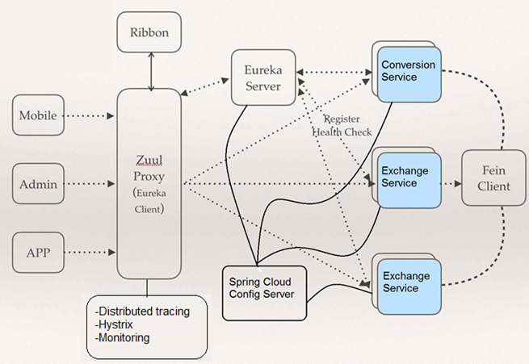
Spring Cloud Components
Ribbon : Provided by Netflix provides Client side load balancing, Server side load balancing may be bottle neck
Zuul :API Gateway
Eureka : Provided by Netflix.
Service registery and discovery
Config Server: Centralized place for configuration
Feign Client : Proxy rest client help simplifying code to invoke microservices
Sleuth & Zipkin : Unique request ID and distributed tracing
Hystrix : Failover resilience
Notes:
Server side load balancing may be bottle neck so provisioned client side load balancing

Slide 13

Enough Theory

Slide 14

Time for Practical

Slide 15
Configuration Management
Spring Cloud Config Server
Multiple microservices
Multiple instances
Multiple Configuration
To manage all these stuff, spring provides config server , to store at once place .

Slide 16
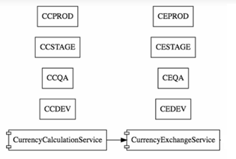
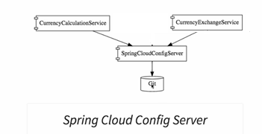
Production Environment

Slide 17
Resources
https://dzone.com/articles/microservices-in-practice-1
https://dzone.com/articles/the-12-factor-app-a-java-developers-perspective
https://www.slideshare.net/ewolff/microservices-with-spring-boot-and-spring-cloud
Domain-Driven Design: Tackling Complexity in the Heart of Software - Eric Evan
Design and Governance of Microservices
https://martinfowler.com/microservices/
12 Factor App
https://12factor.net/
Spring Cloud
http://projects.spring.io/spring-cloud/

